Slide 1

JEFA
Zhang Zhexian - 0545080 - zhangzhexian@outlook.com Fanuel Wahjudi - 0556162 - fanuelwahjudi.edu@gmail.com Setiawan Wibowo P. - 0556165 - setiawantong.cs05g@nctu.edu.tw
Course Project for 3D Game Programming, NCTU, 2017/01

Slide 2
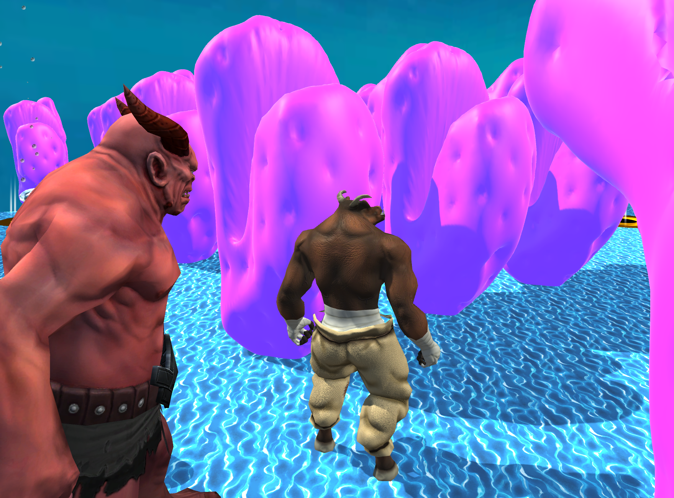

Slide 3
Introduction
Jefa is the first game released by our team that designed and produced with unity3D. This game redefines traditional maze game in a 3D cube world which makes it engaging yet challenging.
Main features of Jefa include 3D cube maze minimap, multiple game levels and scenes, intuitive character movement control, as well as self-developed 3D models, sound effects and particle effects.

Slide 4
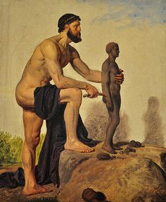
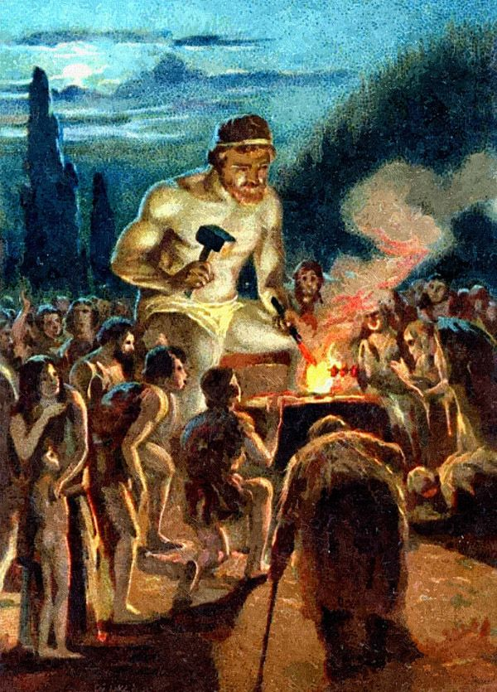
Game story

Slide 5
Game Play

Slide 6
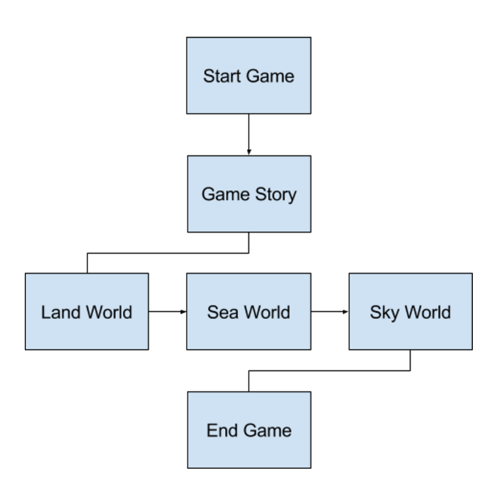
Game Flow

Slide 7
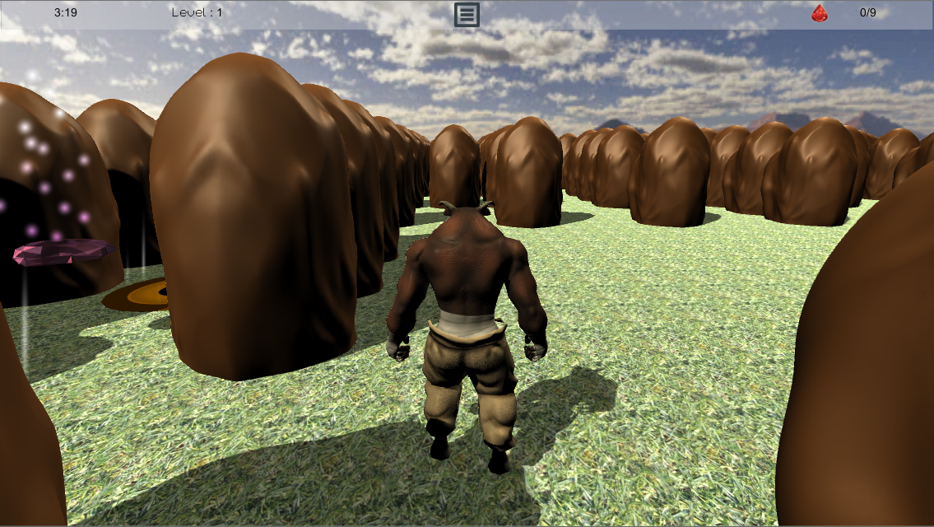
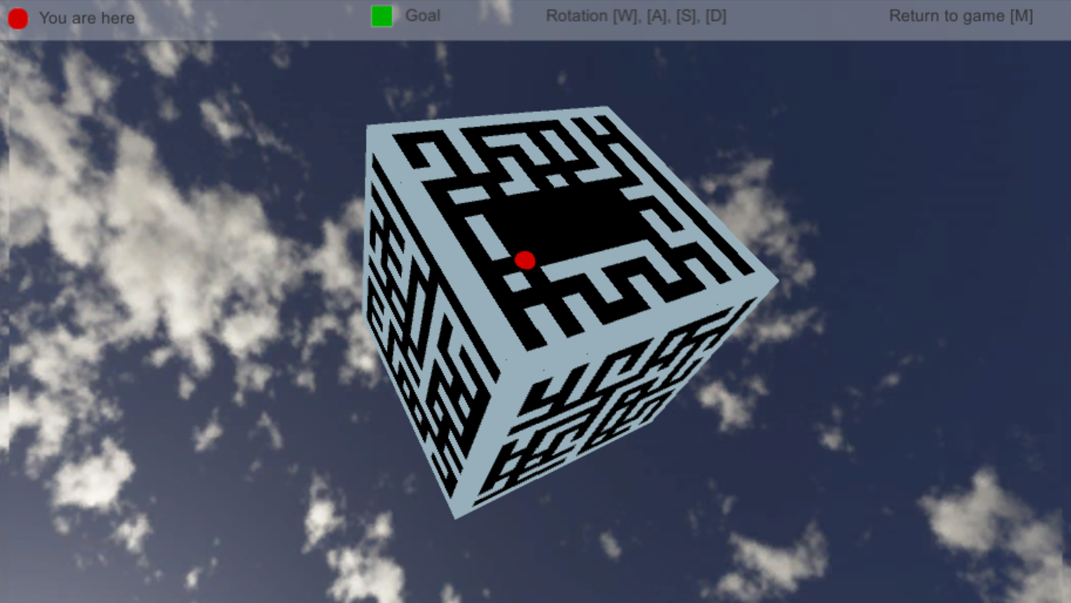
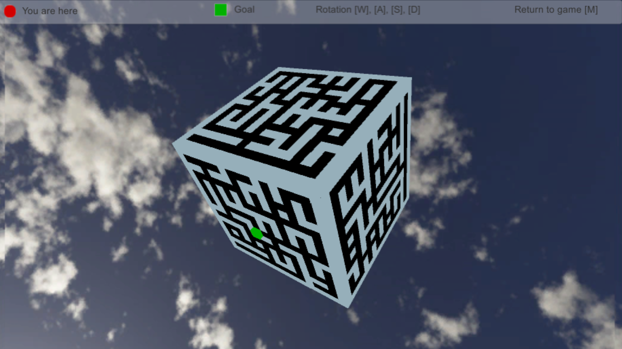
Game goal

Slide 8
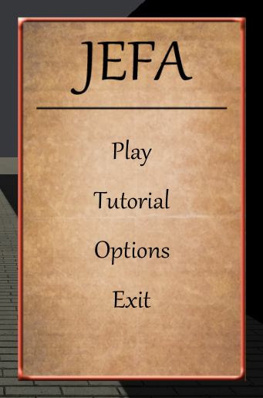
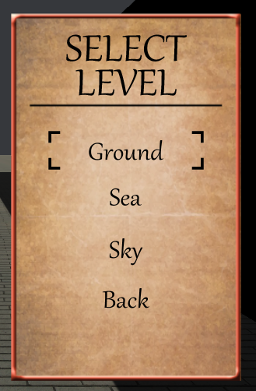
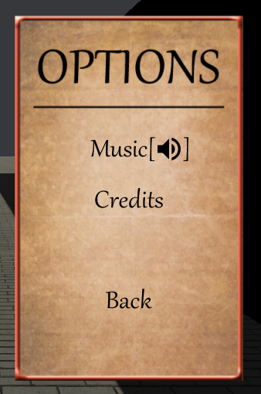
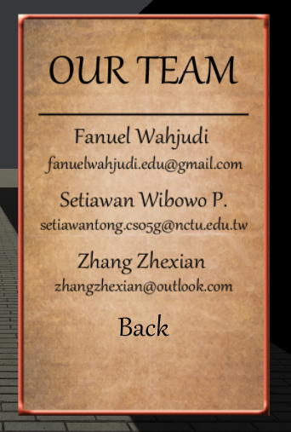
Navigation

Slide 9
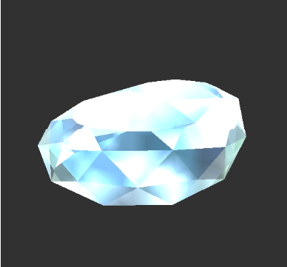
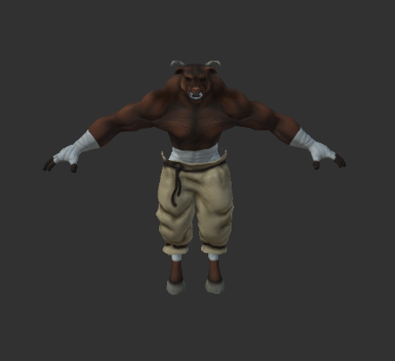
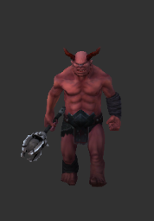
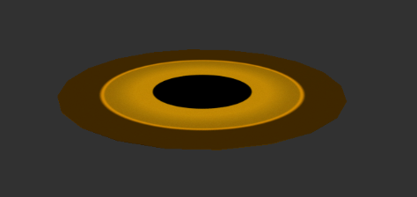
Characters & Objects

Slide 10
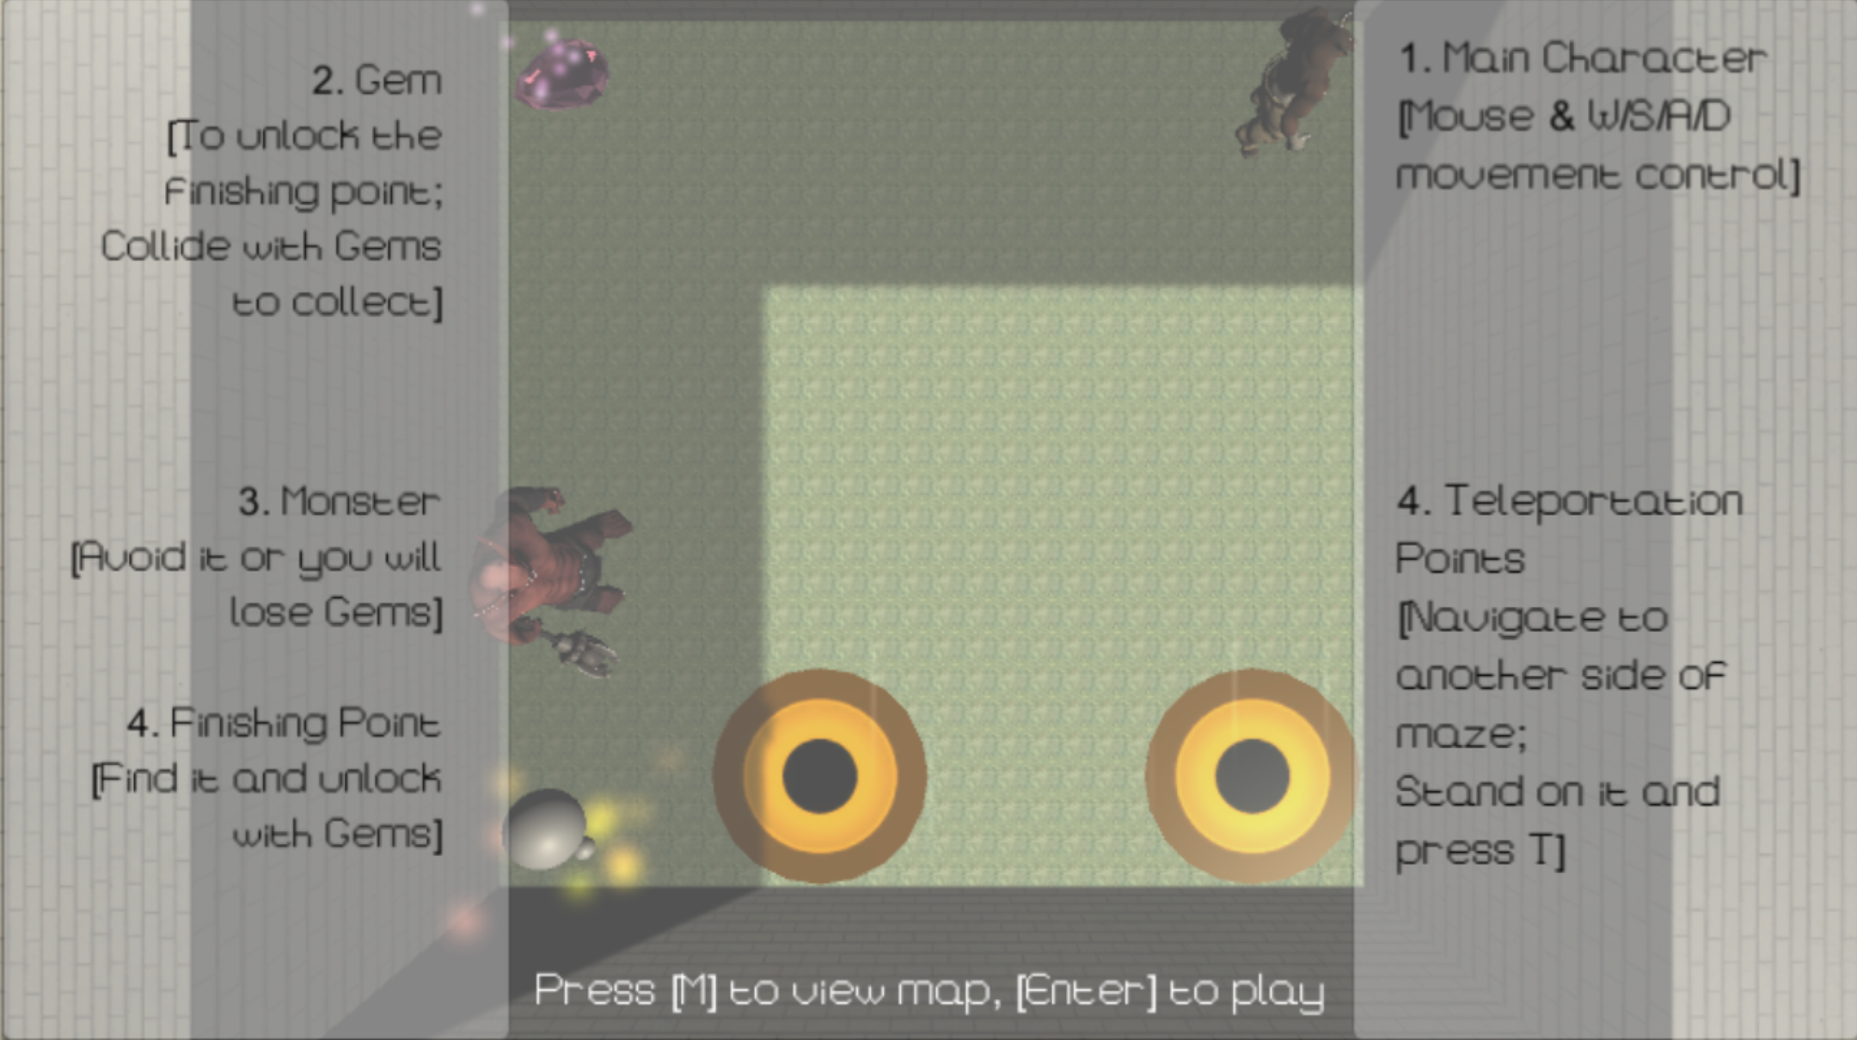
Controls

Slide 11
GUI (legend)

Slide 12
Game maps (Land)

Slide 13
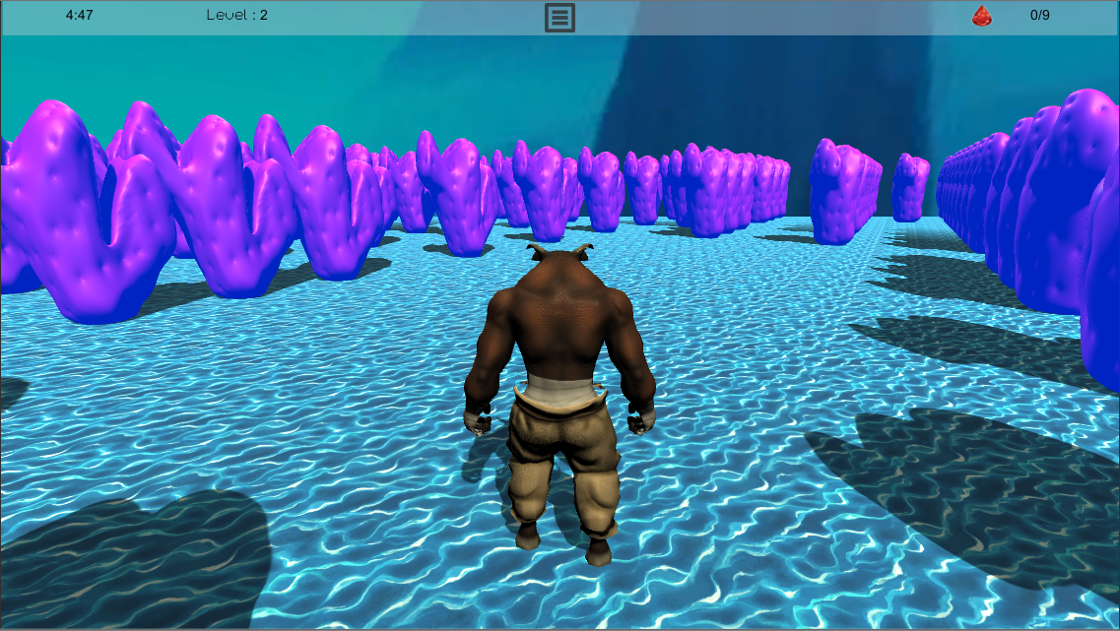
Game maps (Sea)

Slide 14
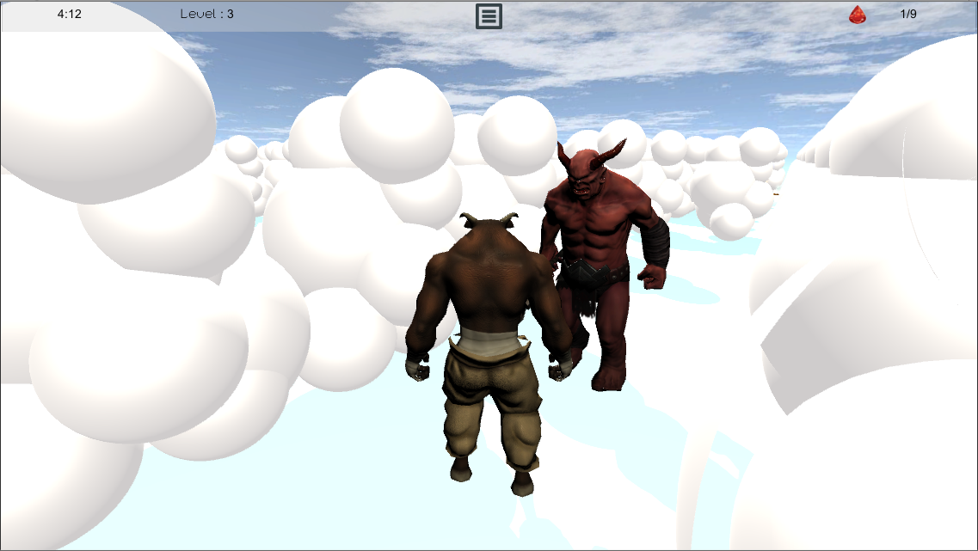
Game maps (Sky)

Slide 15
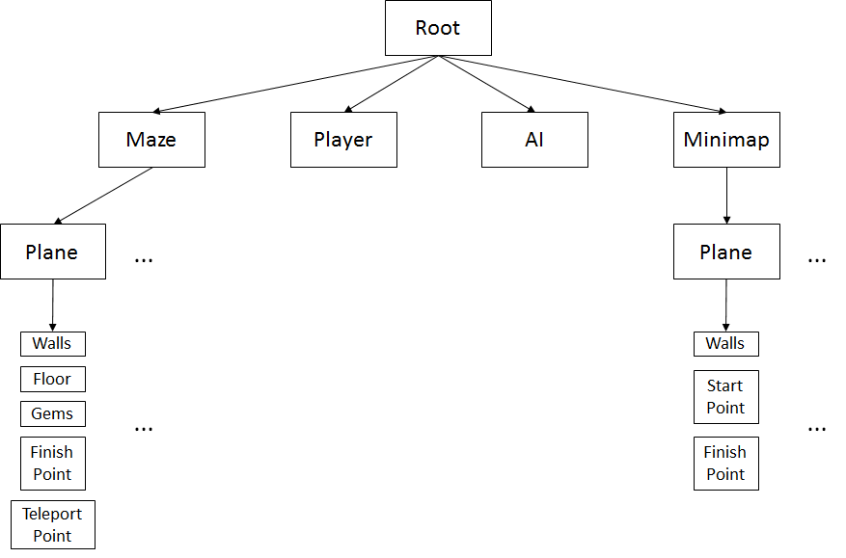
System architecture (Objects Hierarchy)

Slide 16
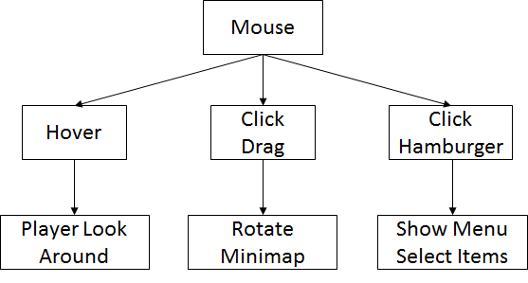
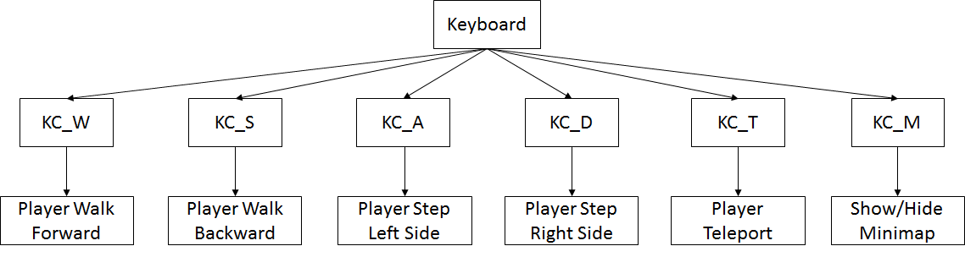
System architecture (Controller Hierarchy)

Slide 17
Game Technology

Slide 18







Recursive Division
Technique
1 2 3 4
5 6 7

Slide 19
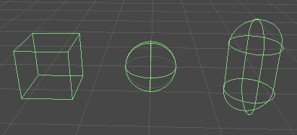


Colliding System
Bounding Box Technique
Same-Coordinate Technique

Slide 20
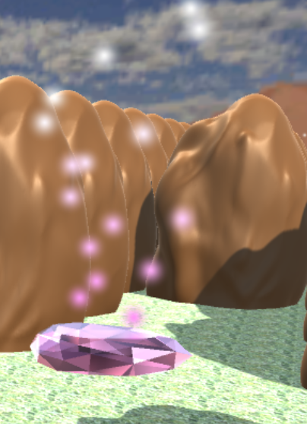
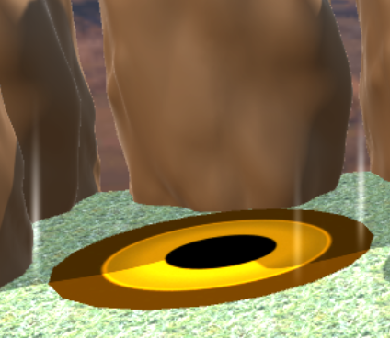
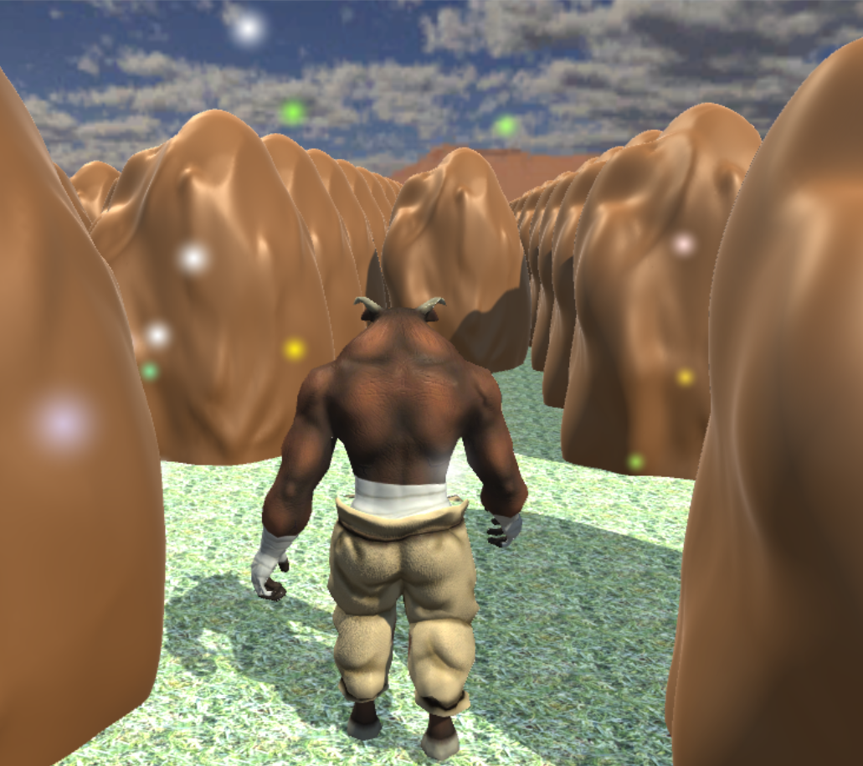
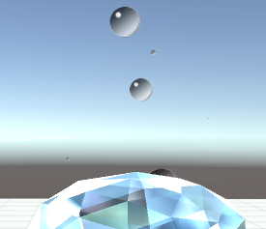
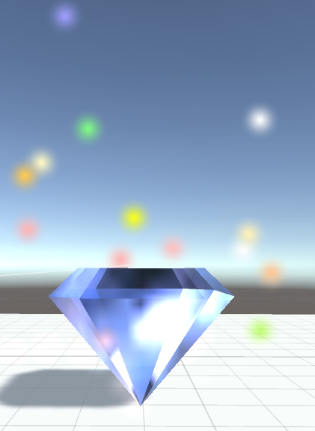
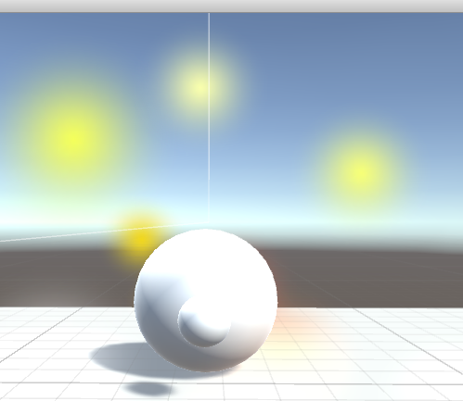
Particle System

Slide 21
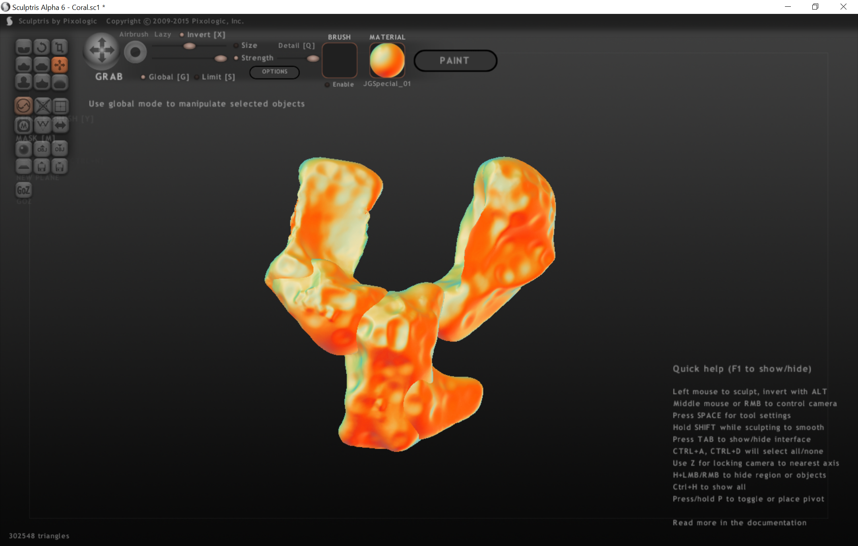
Creating Mesh (Pixologic Sculptris)

Slide 22
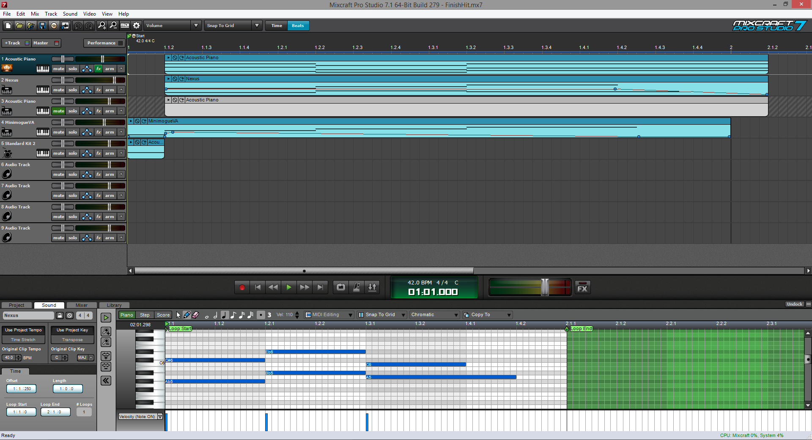
Creating SFX (Acoustica Mixcraft)

Slide 23
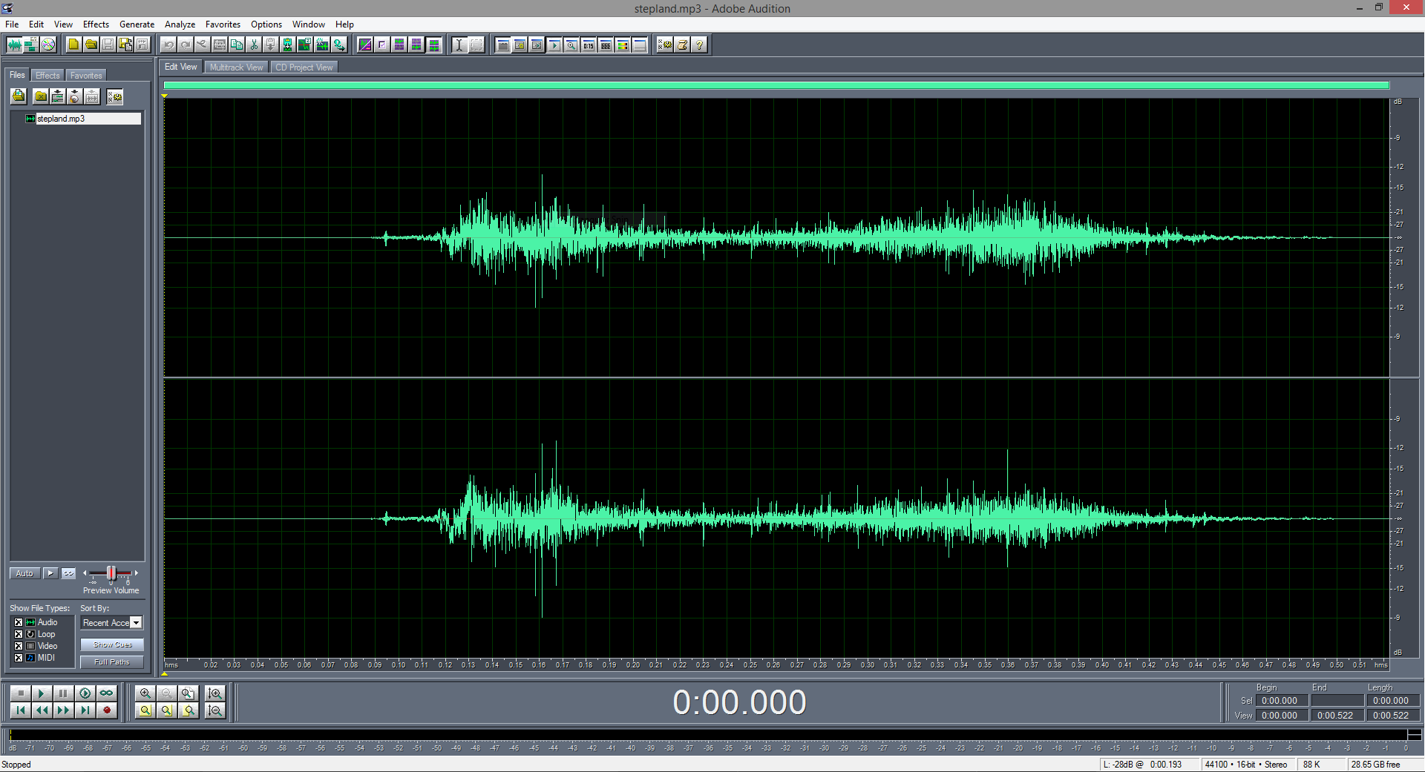
Creating SFX (Adobe Audition)

Slide 24
Sound clips
Background Music:
Main Menu
Land Level
Water Level
Sky Level
Sound Effects:
Button Click
Finish
Hit by monster
Foot Step Land
Foot Step Water
Foot Step Sky
Teleport

Slide 25
AI
finite
state
machine

Slide 26
Character
finite
state
machine

Slide 27
Schedule & Contributions
Go to todo list: https://docs.google.com/spreadsheets/d/1X92T32BK4nugwOaiMnOKQSW9NSy6d0IUFp5pSsP7ozg/edit

Slide 28
Demo

Slide 29
Conclusion
We learnt the processes in developing this game:
Game elements, apply math & phy, C# scripting, UI meshes, sound effects, and sprite creation.
Software development process, teamwork, task management, presentation, and report.
The game programming is very fun. You create your own world!

